Slide 1

Aim: why is the excretory system so important to all organisms

Slide 2
Aim: why is the excretory system so important to all organisms
Do Now: state the difference between egestion and excretion.

Slide 3
Excretory System
Goals:
- All students will understand how the body removes waste.
-Students will understand the different organs of the excretory system.

Slide 4
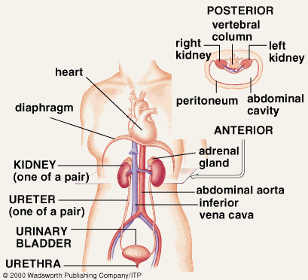
Excretory System

Slide 5
Excretion
The removal of metabolic waste from the body.
Includes carbon dioxide, water, salt, and urea.
Waste diffuses from cells into blood and then out of the body through different organs.

Slide 6
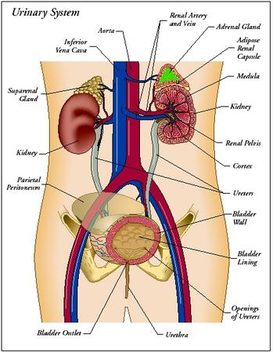
Excretory System

Slide 7
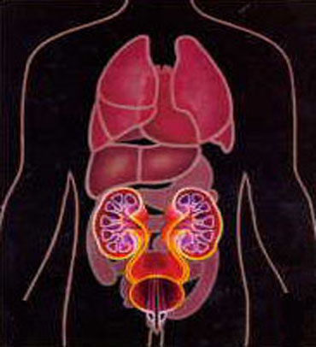
Excretory System
Organs
Lungs
Carbon Dioxide
Liver
Sweat Glands
Kidneys

Slide 8
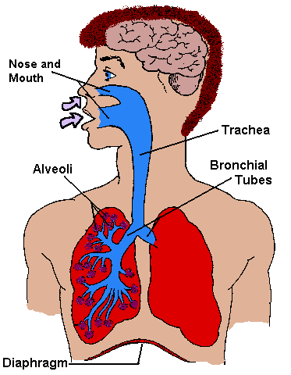
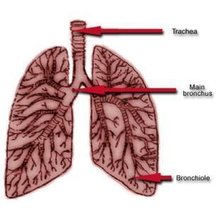
Excretory System
Lungs
Remove the waste products of cellular respiration
Carbon Dioxide and water vapor

Slide 9
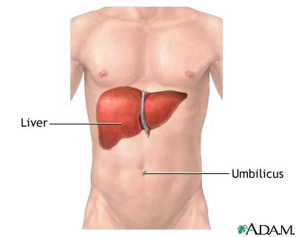
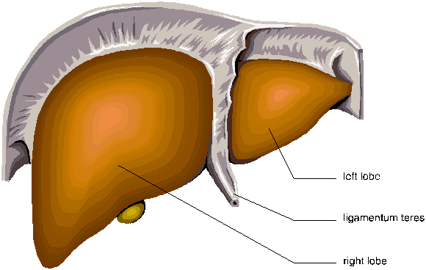
Excretory System
Liver
Breaks down and gets rid of excess amino acids
Converts amino acids to urea
Breaks down red blood cells

Slide 10
Excretory System
Sweat Glands
Excrete waste, water, salts, and small amounts of urea.
This waste diffuses between capillaries and sweat glands.
The mixture of waste and water is perspiration.
Regulates body temperature (homeostasis).

Slide 11
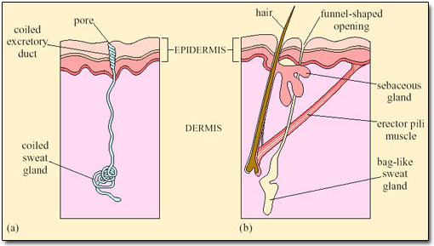

Slide 12
Questions
Which human body system includes the lungs, liver, skin, and kidneys?
Respiratory
Digestive
Transport
excretory

Slide 13
Questions
In humans the organ that breaks down red blood cells and amino acids is the?
Kidney
Liver
Gallbladder
Small Intestine

Slide 14
Aim: how would a disruption in the excretory system affect your body?
Do Now: state 3 organs of the excretory system along with there function.
Homework: None

Slide 15
Aim: How does the build up of waste affect our body’s?
Do Now: How can you tell if your body is properly hydrated?
Homework: text book pg 595 – 599 Questions 1-5 on pg 599

Slide 16
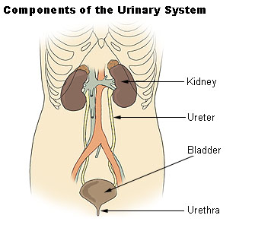
Urinary System
The body system that filters and excretes waste out of the body.

Slide 17
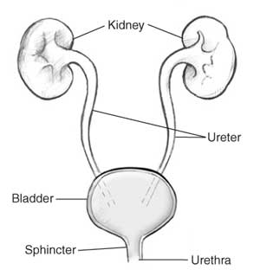
Urinary System
Organs
Kidneys
Ureters
Urinary bladder
Urethra

Slide 18
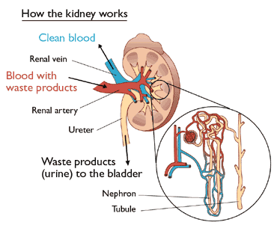
Urinary System
Kidney’s
Main function is filtration.
Removes urea from blood.
Nephron is the functional unit of the kidney.
Urine is created here.

Slide 19
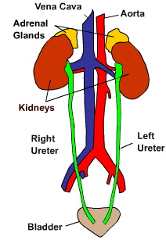
Urinary System
Ureters
The large tubes connected to the kidneys and the urinary bladder.

Slide 20
Urinary System
Urinary Bladder
A muscular organ that temporarily stores urine.

Slide 21
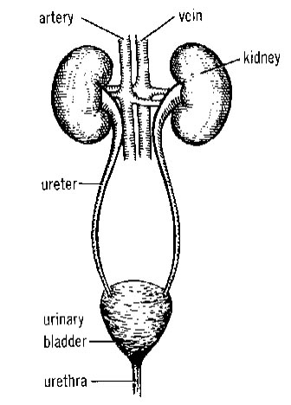
Urinary System
Urethra
A tube that expels urine out of the body.

Slide 22
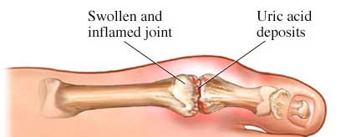
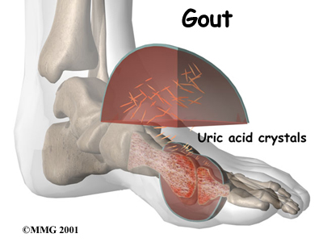
Diseases of the urinary system
Gout
Causes symptoms similar to arthritis.
Is caused by deposits of uric acid in the joints.
Patients may suffer from severe pain and stiff joints.

Slide 23
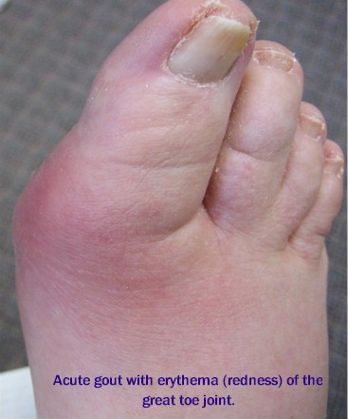

Slide 24
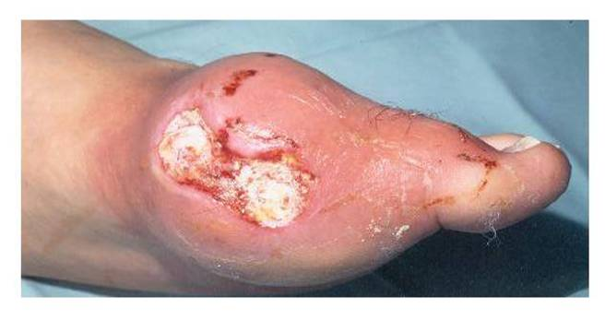

Slide 25
Sometimes people have this urge to urinate shortly after visiting the restroom. Then when they try to urinate, only a little urine comes out. This mostly happens during a bladder or urinary tract infection.
Frequent urination is also a sign of pregnancy. The growing uterus applies pressure on the urinary bladder, which causes one to urinate frequently. Moreover, during pregnancy blood flow to the kidneys increases rapidly, thereby resulting in faster filtration and urine formation. About 2 to 4% pregnant women develop urinary infections, which can also be the reason for frequent urination sensation.

Slide 26
Urine is often diluted and added to potted plants and plants in gardens. This is because, the adequate urea content in urine is a wonderful source of nitrogen to plants. So if you have a garden, you now know what to do!

Slide 27
Have you heard of urine therapy? Well, urine therapy involves application of urine for medical or cosmetic purposes. People apply urine on the skin and even drink urine for medicinal benefits. Don't freak out, they drink their own urine only! Moreover, during wars in historic times, urine was applied on open wounds to destroy bacteria, due to its antiseptic qualities. According to them, the darker the urine, the more effective would be the urine!

Slide 28
Urine should normally contain only salts, metabolic wastes and fluids. However, at times sugar is seen to be present in the urine. This is an indication of diabetes. Some other problems associated with the urinary system are polyuria (excess urine production), oliguria (little urine production), dysuria (difficulty and pain in urination), kidney failure, kidney stones, bladder control problems, prostate enlargement and urinary tract infections.

Slide 29
Most of us have found ourselves in situations where we have had to control our full bladders due to the unavailability of a restroom. However, there is a control limit which shouldn't be exceeded. In the year 2007, Jennifer Strange (age 28) of California participated in a radio station's contest that involved drinking the maximum water without having to visit the restroom. She won the contest, however, was found dead the next day in her house. Doctors confirmed she died of water intoxication. Thus, it is important not to take the importance of the urinary system lightly.

Slide 30
Questions
Which human body system includes the lungs, liver, skin, and kidneys?
Respiratory
Digestive
Transport
excretory

Slide 31
Questions
In humans, the filtrate produced by the nephrons is temporarily stored in the?
Glomerulus
Alveolus
Gallbladder
Urinary Bladder

Slide 32
Questions
The basic structural and functional excretory units of the human kidney are known as?
Nephridia
Nephrons
Alveoli
Ureters

Slide 33
Questions
In humans the organ that breaks down red blood cells and amino acids is the?
Kidney
Liver
Gallbladder
Small Intestine

Slide 34
Questions
Briefly describe how each of the following functions as an excretory organ
The liver;
The skin;
The lungs;

